Slide 1

Asset Management Companies
Blackrock
Group 6

Slide 2
Overview of BlackRock
Objective: Introduce BlackRock’s business model, scale, and importance of its revenue structure, emphasizing aspects relevant to the risks and simulations.
Key Facts & Figures:
AUM: $10.01 trillion (2023), making it the largest asset manager globally.
Split: 26% Active ($2.62T), 74% Passive ($7.38T, including ETFs and index funds).
Global presence: Major geographical asset split (US: $6.37T; Europe, Middle East, and Africa: $2.48T; Asia-Pacific: $802B; Americas ex-US: $356B).
Revenue Structure:
Management Fees: The largest revenue driver, comprising both fixed and performance-linked fees. Example: ETFs and index funds generate lower margins but scale amplifies revenue.
Performance Sensitivity: Variable components of revenue are tied to fund performance, introducing market risk.
Geographical Diversification: FX exposure arises from managing assets in different currencies.
Business Relevance:
Over 50% of AUM relates to retirement solutions, with many products designed for long-term investors.
Increasing focus on innovation through Aladdin (technology platform), sustainable investing, and infrastructure funds.

Slide 3


BlackRock's Key Risk Management Strategies
BlackRock, a global investment management corporation, faces various risks in its operations. This presentation explores three critical risk areas: Market Risk, Client Redemption and Liquidity Risk, and Foreign Exchange Risk. We'll examine their definitions, quantification methods, and impact on BlackRock's business.

Slide 4
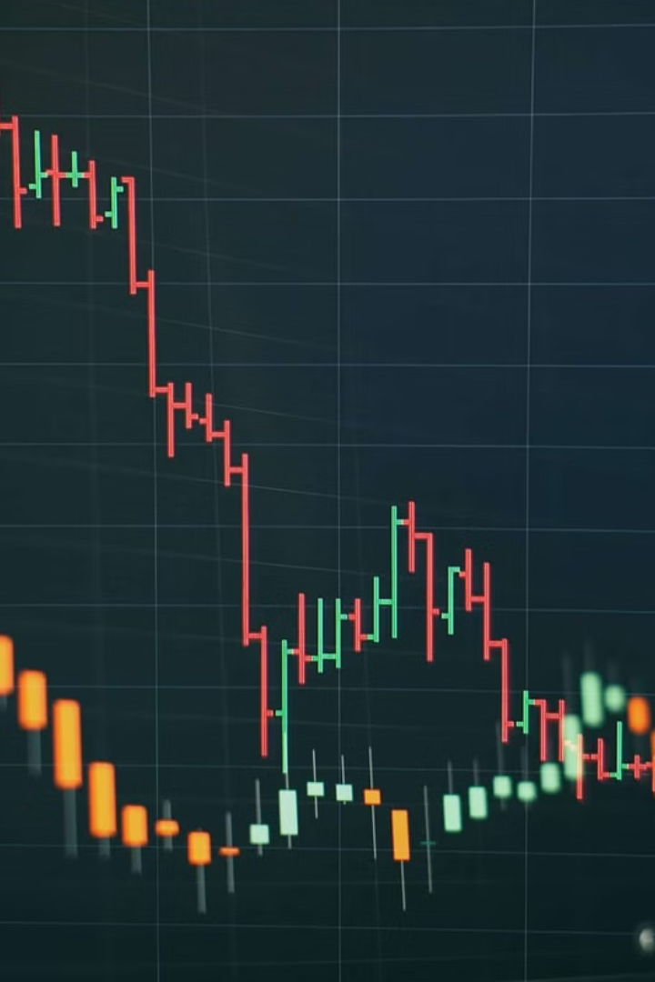
Market Risk: Navigating Economic Turbulence
1
Definition
Market risk represents potential losses due to adverse market movements affecting Assets Under Management (AUM) and fee-based revenue.
2
Key Factors
Economic shifts, geopolitical events, and global market volatility contribute to market risk. Recent concerns include inflation, deglobalization, and energy transitions.
3
Quantification Methods
BlackRock employs Value at Risk (VaR) to measure potential portfolio losses. Stress testing simulates extreme scenarios to assess AUM and revenue impacts.

Slide 5

Client Redemption and Liquidity Risk
Definition
Key Concerns
The risk of significant client withdrawals leading to decreased AUM and potential liquidity challenges.
Sudden redemptions during market downturns or financial stress periods can pressure fund management and securities lending.
Quantification Tools
Mitigation Strategies
BlackRock monitors Redemption Rates and maintains a Liquidity Coverage Ratio (LCR) to assess short-term obligations.
Maintaining adequate liquidity buffers and implementing prudent risk management practices are crucial for mitigation.

Slide 6
Foreign Exchange (FX) Risk: Global Operations Challenge
Overview
Quantification Methods
Strategic Considerations
FX risk arises from BlackRock's global operations. Exchange rate fluctuations can impact earnings and cross-border investments.
BlackRock assesses Currency Exposure as a proportion of AUM in foreign currencies. FX VaR measures potential losses from adverse currency movements.
As BlackRock expands internationally, managing currency volatility becomes crucial for maintaining stable returns and client satisfaction.

Slide 7
Client Redemption and Liquidity Risk
Definition
Key Concerns
The risk of significant client withdrawals leading to decreased AUM and potential liquidity challenges.
Sudden redemptions during market downturns or financial stress periods can pressure fund management and securities lending.
Quantification Tools
Mitigation Strategies
BlackRock monitors Redemption Rates and maintains a Liquidity Coverage Ratio (LCR) to assess short-term obligations.
Maintaining adequate liquidity buffers and implementing prudent risk management practices are crucial for mitigation.

Slide 8
Market Risk Simulation
Establishing the context: Market Risk → AUM →
Revenue Model:
Management fees are calculated as a percentage of AUM (e.g., 0.15% for passive, 0.75% for active funds).
Performance fees depend on fund returns, which are market-sensitive.
Impact Pathway:
Market risk leads to fluctuations in AUM due to valuation changes and investor redemptions.
Reduced AUM leads to lower management and performance fees, directly affecting revenue.
Why Market Risk Matters:
Market Volatility: Reduces AUM by affecting asset valuations.
Investor Redemptions: High volatility can lead to outflows, further reducing AUM.

Slide 9
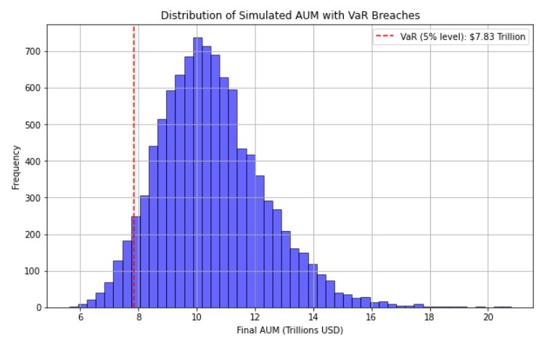
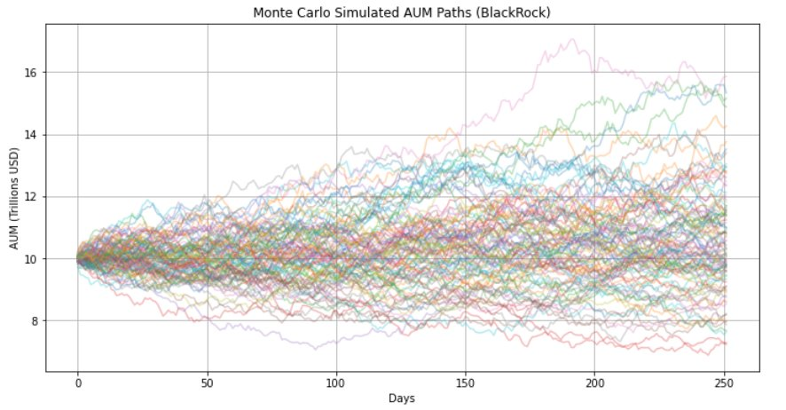
Simulating AUM under Market Risk
Methodology:
Historical returns from major indices (S&P 500, EURO STOXX 50, Hang Seng) were used.
Monte Carlo simulation of 10,000 paths over 252 trading days.
Applied BlackRock’s regional AUM weights (US: 63.7%, Europe: 24.8%, Asia-Pacific: 8.0%).
Metrics:
Mean AUM: Central tendency across simulations.
5% VaR: Threshold AUM for the worst 5% outcomes.
5% CVaR: Average AUM in the worst 5% scenarios.
Max/Min AUM: Extreme outcomes in simulations.

Slide 10
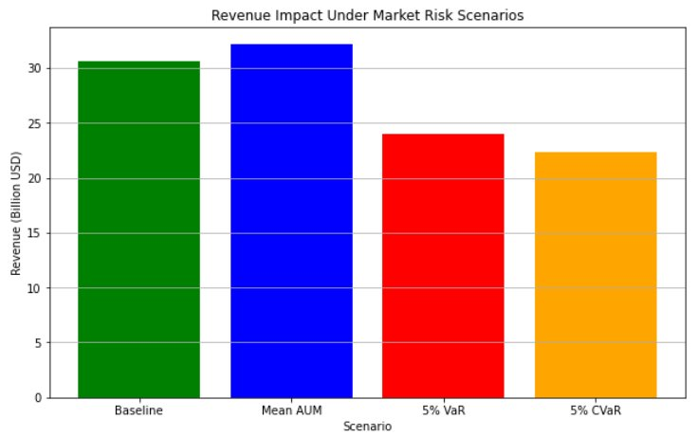
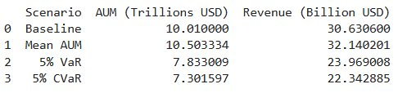
Stress Testing
Stress Scenarios:
Market Crash: 10% drop in global indices.
Correlation Spike: Regional indices move together (correlation = 1.0).
Volatility Surge: Index volatilities increase by 50%.

Slide 11

Methodology
Objective:
Analyze Forex Risk for BlackRock’s portfolio exposed to EUR and JPY against USD.
Approach:
Use Monte Carlo Simulation with GARCH models to simulate portfolio returns under extreme market conditions.
Compare simulated results with historical returns to validate risk measures.
Portfolio Composition:
Exposure: EUR: €2,500 billion JPY: ¥800 billion
BlackRock's AUM breakdown

Slide 12
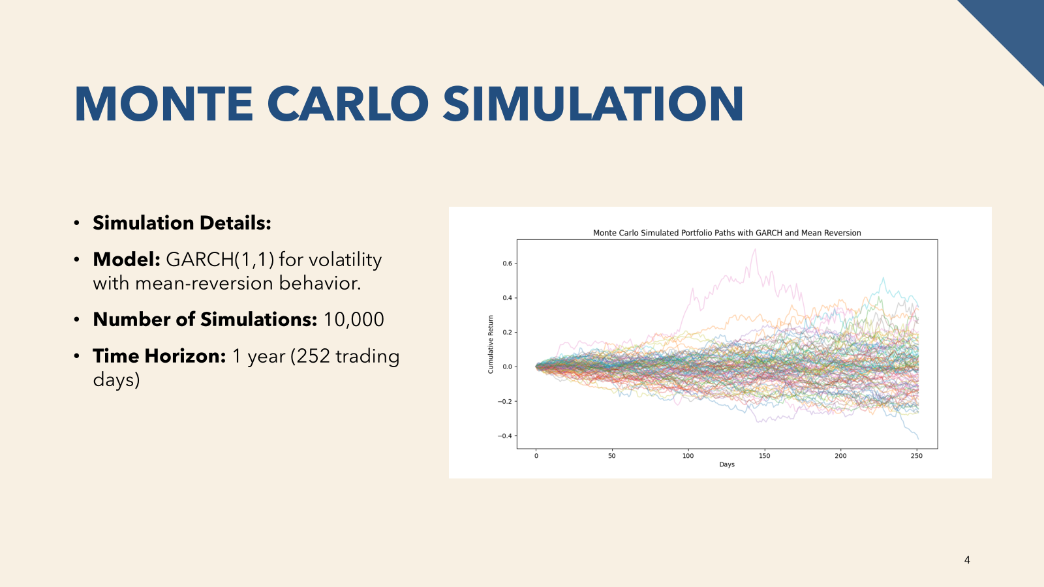

Redemption Risk & BlackRock
What is Redemption Risk?
Risk of large-scale withdrawals in funds like mutual funds and ETFs.
Bear Market Impact on Redemption Risk
Negative sentiment increases redemptions as investors seek to minimize losses.
"As share prices decline, bear markets generate fear, leading some to sell stocks for cash." — Charles Schwab
Key Risks for BlackRock
Increased Withdrawals: Liquidity strain as investors pull out due to negative market sentiment.
Discounted Asset Sales: Forced sales at lower prices, reducing returns and impacting fund performance.
Redemption Rate & AUM Analysis
Rate Calculation: 0.1% base rate on positive returns; increases with negative returns up to 5%.
AUM Adjustment: Updated for returns and redemption amounts.
Risk Visualization: Probability analysis of AUM falling below 50% of initial value, with distributions of final AUM and cumulative redemptions.

Slide 13
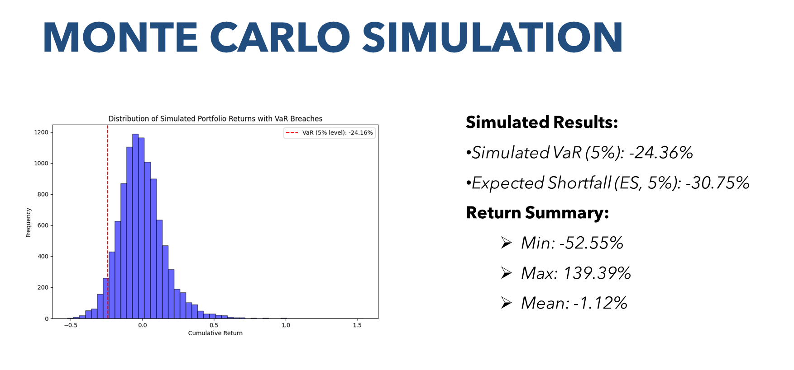
Forex Risk

Slide 14
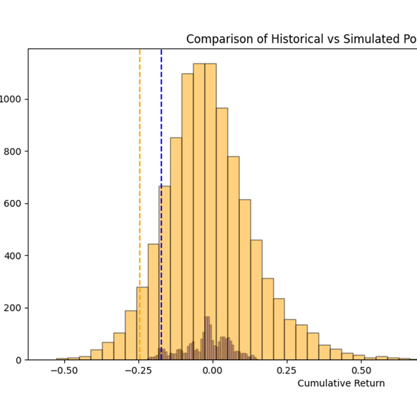
Historical Comparison
Historical Portfolio Analysis:
•Timeframe: 2013-2023
Results:
•Historical VaR (5%): -17.19%
•Historical ES (5%): -18.67%
•Return Summary:
ØMin: -22.03%
ØMax: 15.33%
ØMean: -2.26%

